Slide 1

Internet Usage and its Analytics
By- Pratiksha , Anshika, Navin , Obulesu, Himali, Karthik
BY Pratiksha, Anshika, Navin , Himali ,Karthik, Obelesu

Slide 2
Problem Statement
Analysing and visualizing the internet consumption data around the world to derive insights with regard to internet accessibility of various countries and factors affecting it i.e why other countries are having less access to the internet than other countries and where they are lacking?

Slide 3
Dataset
Content: Worldwide data which consists of the Internet and the Evolution of Broadband around the world.
Attributes in Dataset: Total Population (in number of people), Internet Users (per 100 people), Fixed (wired) broadband subscriptions (per 100 people), Mobile cellular subscriptions, region, country-code, year.
Geographical Coverage: Worldwide.
Time Span: Dependent on the metric set but mostly from 1960 onwards to 2019.

Slide 4
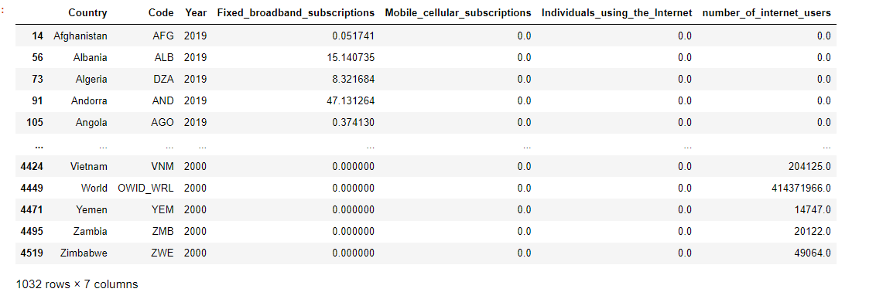
Final Dataset

Slide 5
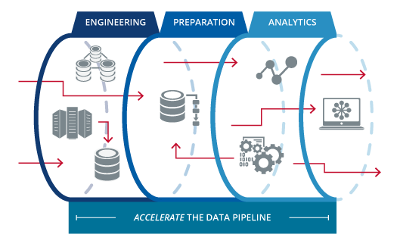
Data-Pipeline

Slide 6
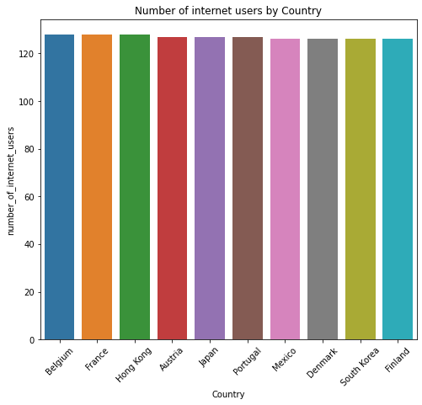
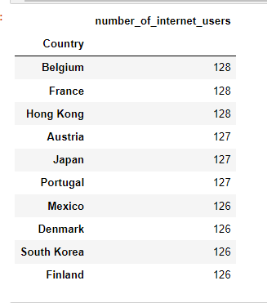
Number of Internet Users by Country

Slide 7
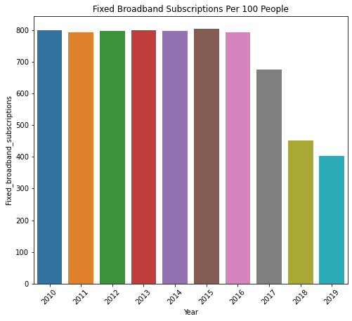
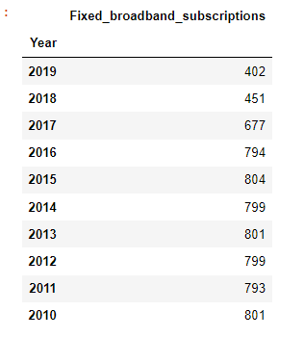
Fixed Broadband Subscription per 100 people

Slide 8
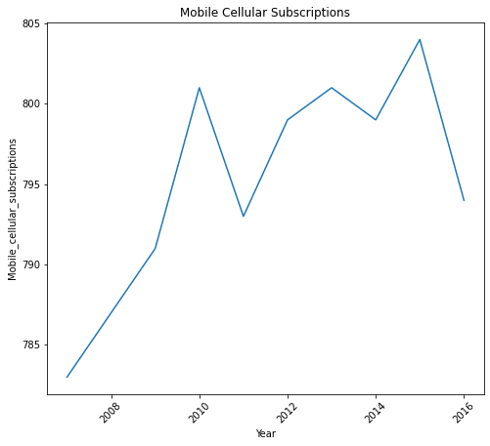
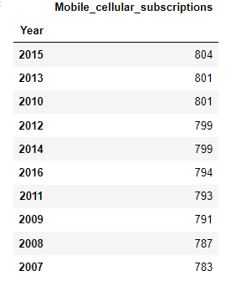
Top 10 Mobile Cellular Subscriptions per 100 people From 2007-2016

Slide 9
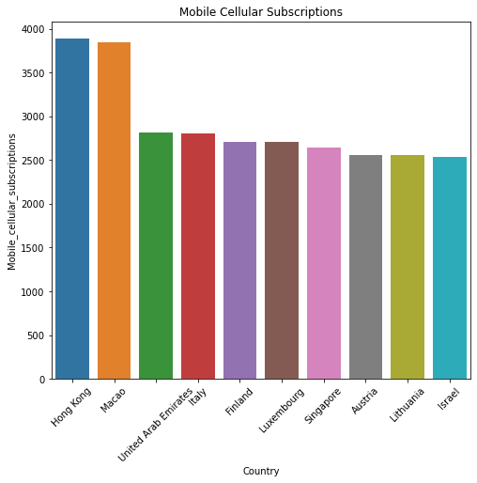
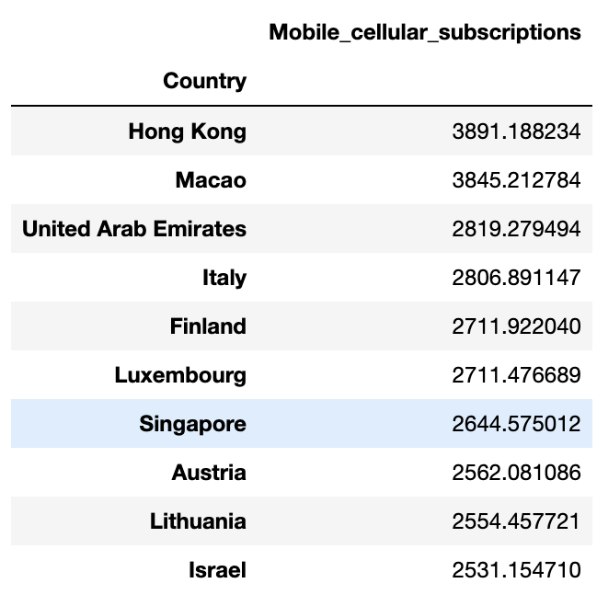
Mobile cellular subscriptions For Top 10 Countries

Slide 10
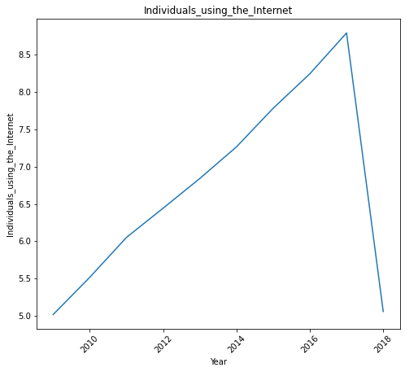
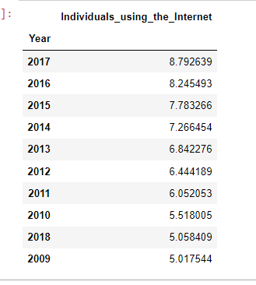
Share of the Population using the Internet (% of population)

Slide 11
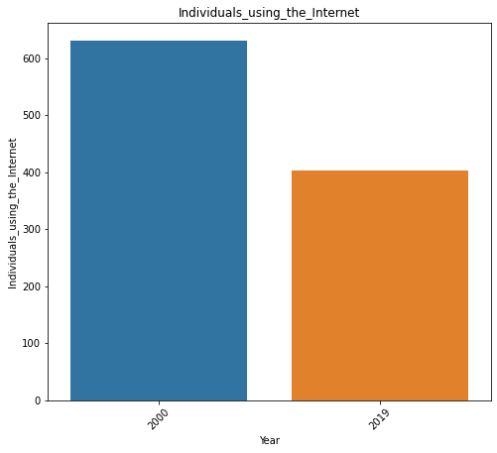
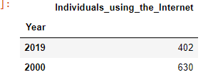
Change In Percentage For Internet Usage From 2000-2019

Slide 12
Interactive Power-bi Dashboard Using Sql Format Dataset

Slide 13
Proposed Solution and Its Impact
Solution | Impact
Reducing taxes | Boost Internet usage and thereby improve access to the digital economy
Zero rating services | Zero rating programs represent effective ways to bring poor people from the developing world into the digital era and promote innovation and competition in the Internet sector.
Providing diverse and uncensored content | This reduces the time required to visit government offices or provide paper documents for tax officials It demonstrates that people are open to digital services when those products are affordable and accessible.
Expanding digital infrastructure | Reduce gaps in digital access, boost the speed of internet connections by using balloons , satellite and drones.
Strengthening digital literacy | Showing people the value of diverse content and having consumers expand their usage of basic services can propel digital activities in a variety of other areas.

Slide 14
Roles and responsibilities of each member
Pratiksha (Leader) | Anshika | Navin | Obulesu | Himali | Karthik
Eda Part In Pandas | FOUND DATASET And DOCUMENTED DATAPIPELINE | Written-problem Statement | Eda In Pandas | Eda In Pandas | Eda In Pandas
Giving Proposal Presentation | Written Insights Of Dataset | Documented Data-pipeline | Working On Insights | Working On Insights | Eda In Python
Helped In Impact And Solutions In Ppt | Written Impact And Solutions In Ppt | Working On Insights |  | Helped In Analyzing Every Graph And Writing The Stats. | Analyzed The Data In Powebi For Checking The Values
Working On Insights | Done The Visualization In Pandas | Made Power Bi Dashboard |  |  | Working On Insights
Made Power Bi Dashboard | Analysed Every Graph And Written The Stats.

Slide 15


